Slide 1

Capstone Project
Weather Analysis

Slide 2
Introduction
The weather dataset encompasses a wide range of attributes including temperature, humidity, pressure, wind speed, and direction across various cities. Through Excel and SQL analysis, we aim to unveil weather trends, seasonal shifts, and attribute correlations. A Power BI dashboard will provide insightful visualizations for weather monitoring and historical analysis.

Slide 3
Objective
Insights & Findings
Report & Presentation
Analyze weather data to identify trends, seasonal variations, and correlations, and create a Power BI dashboard for weather monitoring and analysis.
Insights and findings gleaned from weather data analysis include seasonal variations, correlations between weather attributes, and trends aiding predictive modeling for informed decision-making.
The report and presentation will showcase comprehensive weather analysis, seasonal trends, correlations, and predictive modeling insights, facilitating informed decision-making and strategic planning.
Goal
Utilize weather data analysis to enhance understanding of climate patterns, facilitating informed decision-making and resource allocation for various sectors.

Slide 4
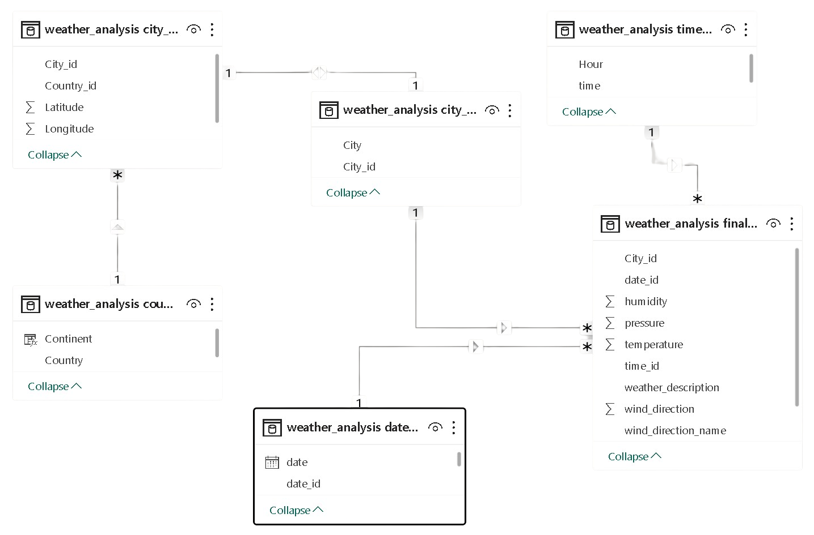
ER Diagram

Slide 5

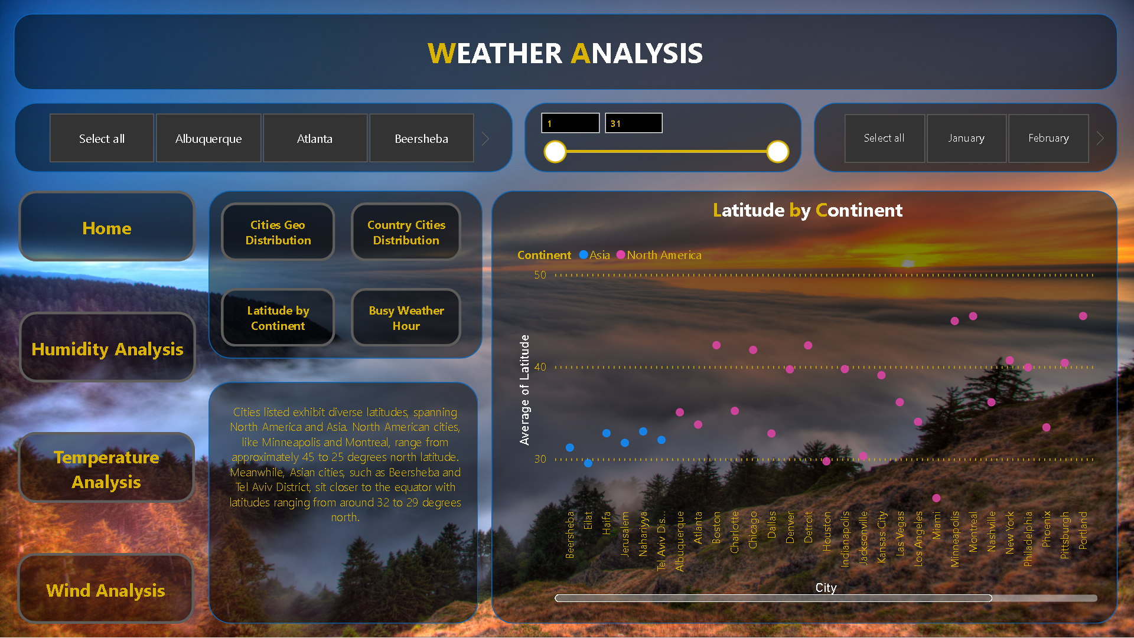
Power BI
Dashboard

Slide 6
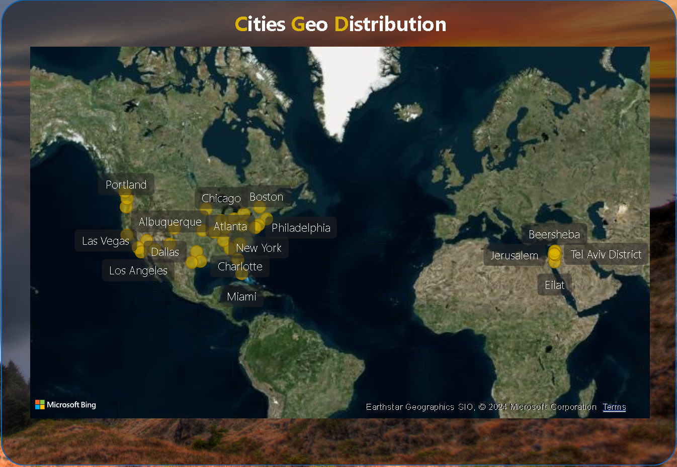
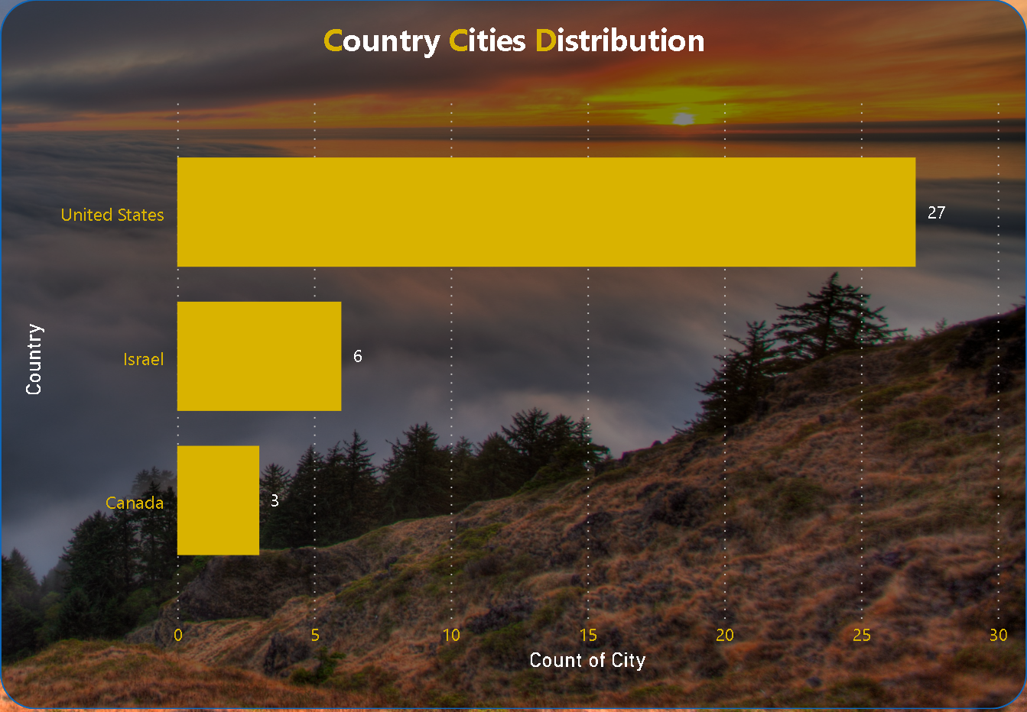
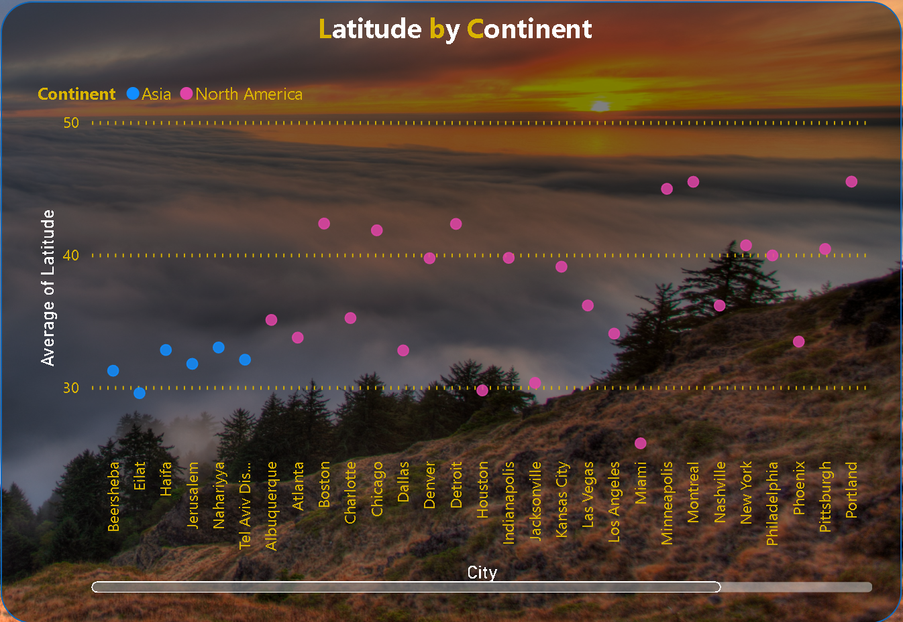
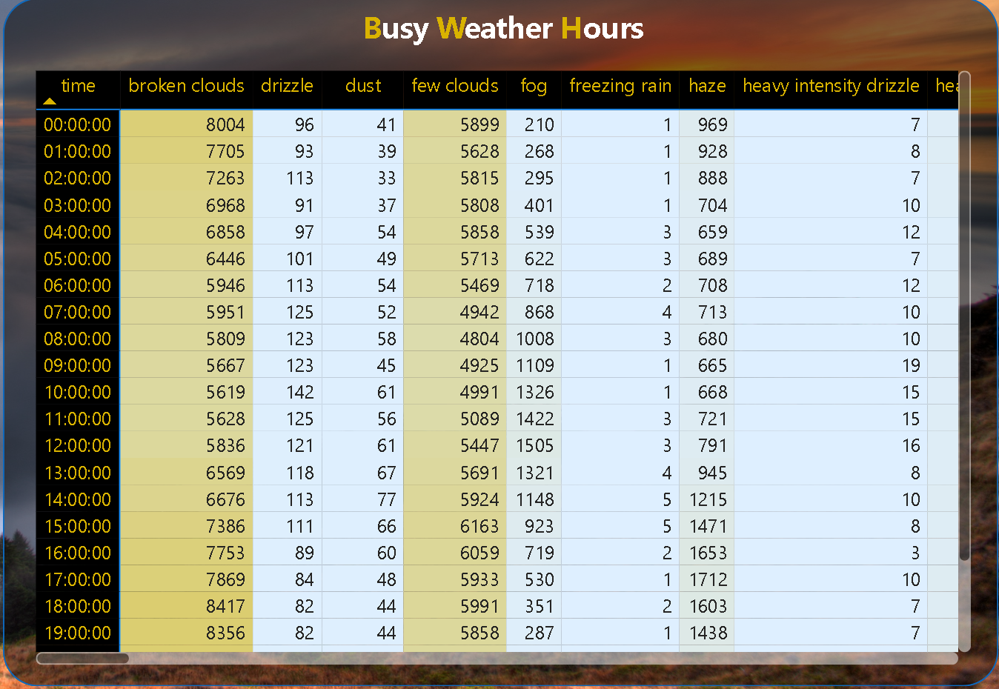
Power BI
Dashboard

Slide 7





Power BI
Home Page
Qualitative weather insights.
Understanding weather conditions.
Categorizing weather types.
Seamless access to different sections.
Streamlined user experience.
Enhances dashboard usability.
Refine data based on preferences.
Customized analysis options.
Tailored insights for users.
Explore weather data by city.
Compare multiple locations.
Understand regional weather patterns.
Home
Navigation
Filter
City

Slide 8
Can you create a geographical map in Power BI showing the distribution of cities in the dataset based on their latitude and longitude?
Each row represents a city, displaying its average longitude, latitude, and count. For instance, Jerusalem stands out with the highest longitude average at 35.22, while Vancouver has the lowest at -123.12. This setup facilitates efficient visualization and analysis.

Slide 9
In Power BI, can you create a bar chart representing the top 10 countries with the highest number of cities in the dataset?
In the analysis of city counts across countries, the United States emerged with the highest count at 27, showcasing a significant lead over Canada, which had the lowest count at 3, marking an 800.00% difference. Following the United States, Israel stood at 6 cities. Remarkably, the United States accounted for 75.00% of the total city count, with Canada and Israel contributing 8.33% and 16.67% respectively. This data underscores the prominence of the United States in terms of city distribution among the countries analyzed.

Slide 10
How does the distribution of cities in terms of latitude vary across different continents? Create a scatter plot in Power BI to illustrate this.
Cities listed exhibit diverse latitudes, spanning North America and Asia. North American cities, like Minneapolis and Montreal, range from approximately 45 to 25 degrees north latitude. Meanwhile, Asian cities, such as Beersheba and Tel Aviv District, sit closer to the equator with latitudes ranging from around 32 to 29 degrees north.

Slide 11
Can you create a heatmap in Power BI to visualize the busiest hours for specific weather conditions (e.g., "clear sky," "rainy")?
The data represents weather conditions recorded at different hours. The most frequent condition is ‘sky is clear’ with 659,181 occurrences. The least common are ‘freezing rain’, ‘proximity sand/dust whirls’, ‘rain and snow’, ‘sand’, ‘squalls’, and ‘tornado’ with only one occurrence each. The total count is 1,629,108.

